Slide 1
NTIRE2025 Challenge on Cross-Domain Few-Shot Object Detection : Methods & Results
This paper advances research on detecting novel objects in new domains with minimal labeled data, pushing models to generalize effectively across significant domain shifts using diverse datasets and evaluation protocols.

Slide 2
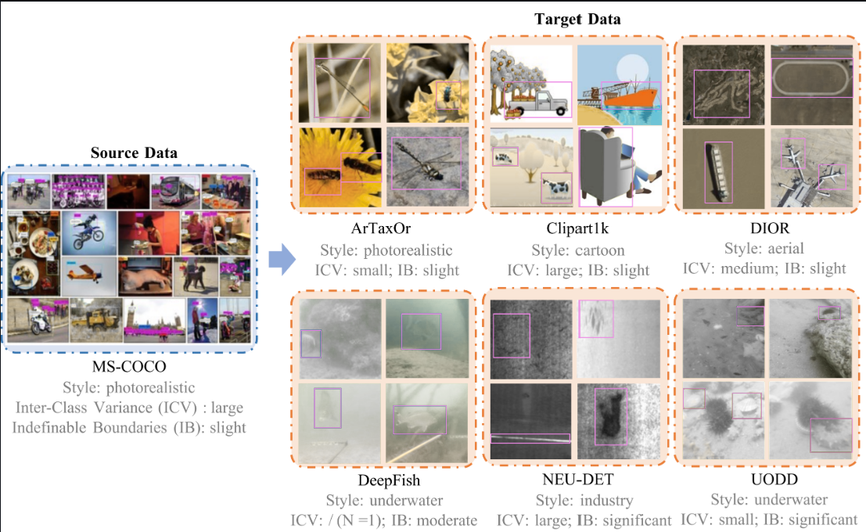

Slide 3
Background
The Cross-Domain Challenge
Why is Cross-Domain FSOD Hard?
Most existing FSOD methods assume that the training (source) and testing (target) data come from the same domain (e.g., both are natural images). However, in real-world scenarios, this is rarely the case. For example, a detector trained on natural images (like MS-COCO) may perform poorly when applied to very different domains such as remote sensing or medical imagery.
Domain Shift: Differences in style, image characteristics, and object boundaries between domains make generalization difficult.
Limited Data: Only a few labeled examples are available for each new class in the target domain.
Real-World Relevance: Addressing domain shift is essential for deploying robust object detectors in varied, unseen environments

Slide 4
Challenge Objective
The NTIRE 2025 CD-FSOD Challenge was launched to push the boundaries of object detection under domain shifts and limited labeled data. The goal is to develop models that can generalize to entirely new domains with only a few labeled examples per class.
Problem Statement & Challenge
Two Tracks: Closed-Source and Open-Source
Closed-Source CD-FSOD:
Training is limited to a single source dataset (MS-COCO).
The classes in the source and target domains are completely disjoint.
Participants must train on the source and adapt to novel target domains with only a few labeled samples per class.
Open-Source CD-FSOD:
Participants can use any datasets and large pre-trained models.
This track explores the upper bound of model generalization, leveraging foundation models and diverse data.

Slide 5
Challenge Setup & Datasets
The challenge uses an N-way K-shot evaluation protocol, where for each novel class in the target domain, only K labeled examples are provided to assist detection. During development, six diverse target datasets with different styles and object characteristics were used for validation. For the final testing phase, three new unseen datasets-DeepFruits, Carpk, and CarDD-were introduced to evaluate model generalization.
The closed-source track restricts training to the MS-COCO dataset only, while the open-source track allows the use of any source data or pretrained foundation models. The primary evaluation metric is Mean Average Precision (mAP), with a weighted emphasis on 1-shot performance to encourage robustness in extremely low-data scenarios.

Slide 6
Main Open-Source Track Methods
MoveFree
AI4EarthLab
IDCFS

Slide 7
Team 1: MoveFree
Open set object detector used (Grounding DINO)
Zero Shot detection possible due to open set object detectors
“Shot” detection (zero-shot, one-shot, few-shot, many-shot)
zero-shot, one-shot, few-shot powerful
Problem 1 : Missing labels can degrade model performance
Solution 1 : Self-training (with each cycle, model gets better at making accurate predictions; more reliable and complete labels)
Problem 2 : Very little data to learn from, and learning and testing environments are different (cross-domain)
Solution 2 : MoE (Mixture of Experts) (System picks the best expert for each task, depending on what the input looks like)

Slide 8
Training Details
Two-Stage Fine-Tuning
Stage 1: Fine-tune the pre-trained model with all parameters trainable, except for the language encoder (kept frozen because it was already working well so there was no need to retrain it).
Stage 2: Introduce MoE architecture in decoder layer, fine-tuning only the MoE components and detection head. All other parts of the model that were fine tuned in stage 1 are now frozen.

Slide 9
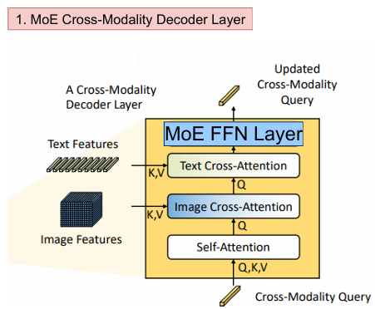
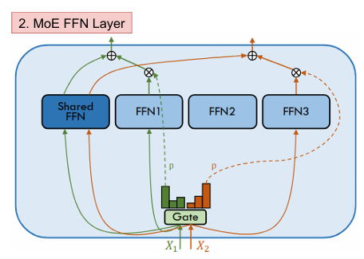

Slide 10
Team 2: AI4EarthLab
Leveraged foundation model Grounding DINO (Swin-B) pretrained on diverse large-scale datasets.
Built a composite augmentation pipeline:
1. CachedMosaic
2. YOLOXHSVRAug
3. RandomFlip
4. CachedMixUp
5. RandomSize
6. CachedCrop
Used coarse grain validation sets for hyperparameter tuning.
Achieved improved robustness and adaptability in CD-FSOD.

Slide 11
Training Details
Conducted experiments on NVIDIA A100 GPUs, with 8 × 50 experiment groups per round.
Selected optimal step sizes based on historical performance.
Applied milestone-based learning rate scheduling (1, 5, 9 epochs).
Used 900 detection queries and a maximum text token length of 256.
Employed a BERT-based text encoder with BPE tokenization.
Network composed of 6-layer feature enhancer and 6-layer cross-modality decoder.
Loss function combined classification loss. L1 box, and GIoU losses.
Used Hungarian matching weights: 2.0 (classification), 5.0 (L1), 2.0 (GIoU); final loss weights: 1.0, 5.0, 2.0.

Slide 12
Team 3: IDCFS
Pseudo-Label Driven Vision-Language Grounding
Combines GLIP (Grounded Language-Image Pretraining) and Grounding DINO for Cross-Domain Few-Shot Object Detection (CD-FSOD).
Iterative Pseudo-Labeling:
Generates high-confidence pseudo-labels during fine-tuning.
Iteratively refines model understanding with these pseudo-labeled samples.
Model Ensemble with Confidence-Reweighted NMS:
Combines GLIP and Grounding DINO outputs.
Confidence scores are reweighted, and Non-Maximum Suppression (NMS) is applied to filter overlaps.

Slide 13
Training Details
GLIP Fine-Tuning:
Full model fine-tuned with a learning rate of 2e-5 for better cross-domain detection.
Iterative Pseudo-Labeling Cycle:
Predict → Generate Pseudo-Labels → Retrain → Repeat.
Enhances model understanding with minimal labeled data.
LoRA-based DINO Fine-Tuning:
Efficiently adapted for new domains using low-memory updates.
Model Ensemble:
Combines GLIP + DINO predictions with confidence-weighted NMS for higher accuracy.

Slide 14
Specialized Close-Source Track Method
X-Few

Slide 15
Team 1: X-Few
Introduced Instance Feature Caching (IFC) to store support features.
Used feature matching for better classification and localization.
Applied contrastive alignment to reduce domain gap.
Built on CD-ViTO with lightweight, adaptive modules.
Enhanced generalization in few-shot, cross-domain settings.

Slide 16
Training Details
Trained on MS-COCO (closed-source), using 1, 5, 10-shot settings.
Used RTX A800 GPU, batch size 16, lr: 1e-3 / 1e-4.
Fine-tuned for 40–200 epochs based on dataset.
Best mAP scores: 50.98 (D1), 28.00 (D2), 33.00 (D3).
Final Score: 125.90 – Ranked 1st in closed-source track.

Slide 17
Our Implementation Approach

Slide 18
Proposed Method
Dataset Preparation
Cloned ETS GitHub repository
Downloaded COCO 2017 annotations & validation images
Extracted files and organized dataset directories
Few-Shot Subset Creation
Created a 5-shot dataset using pycocotools
Selected 5 annotated images per category
Ensured unique images with corresponding annotations

Slide 19
Data Visualization
Loaded few-shot annotations using COCO API
Displayed random sample images with bounding boxes
Verified annotations with category names
Model Setup
Installed transformers & timm
Loaded pre-trained DETR (facebook/detr-resnet-50)
Used DetrImageProcessor for pre/post-processing

Slide 20
Inference & Detection
Selected an image from val2017
Preprocessed & passed it through DETR model
Extracted predictions: labels, scores, bounding boxes
Result Visualization
Drew detection boxes on the image using matplotlib
Displayed class names and confidence scores
Confirmed object detection accuracy visually

Slide 21
Training Details
Model Used: facebook/detr-resnet-50
Pre-training Dataset: COCO
The model was used in evaluation/inference mode without any additional training or fine-tuning.
DetrImageProcessor from HuggingFace was used to handle image pre-processing and post-processing.
No fine-tuning or training of the model was done in this project. The DETR model used was pre-trained.

Slide 22

Group Members
1
Nigarish Rehman Sarmad 22K-8723
2
Unaiza Ahmed Khan 22K-4121
3
Khoula Adil 22K-8733
4
Farheen Fatima 22K-4045
5
Uroosha Zehra Abidi 22K-4048

Slide 23
THANK YOU

